Slide 1
Machine Learning: Field of study that gives computers the ability to learn without being explicitly programmed.
Machine Learning
Grew out of work in AI
New capability for computers
Examples:
Database mining
Large datasets from growth of automation/web.
E.g., Web click data, medical records, biology, engineering
Applications can’t program by hand.
E.g., handwriting recognition, most of Natural Language Processing (NLP), Computer Vision.

Slide 2
Supervised vs. unsupervised Learning
Supervised learning: classification is seen as supervised learning from examples.
Supervision: The data (observations, measurements, etc.) are labeled with pre-defined classes. It is like that a “teacher” gives the classes (supervision).
Test data are classified into these classes too.
Unsupervised learning (clustering)
Class labels of the data are unknown
Given a set of data, the task is to establish the existence of classes or clusters in the data

Slide 3
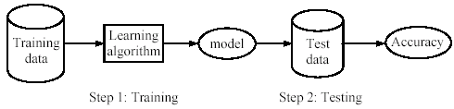
Supervised learning process: two steps
Learning (training): Learn a model using the training data
Testing: Test the model using unseen test data to assess the model accuracy

Slide 4
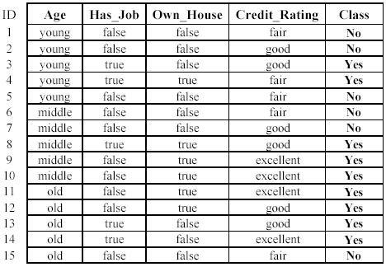
An example: data (loan application)
Approved or not

Slide 5
Unsupervised Learning
x₂
x₁

Slide 6
